Slide 1
Elementary Particle Dynamics
Chapter 2

Slide 2
The Four Forces
Force Relative Strength Range Mediator
Strong 1 ~1 fm gluon
Electromagnetic ${10}^{−2}$ $∞$ photon
Weak ${10}^{−13}$ * ~${10}^{−3}$ fm W and Z
Gravitational ${10}^{−42}$ $∞$ Graviton

Slide 3
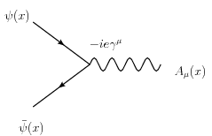
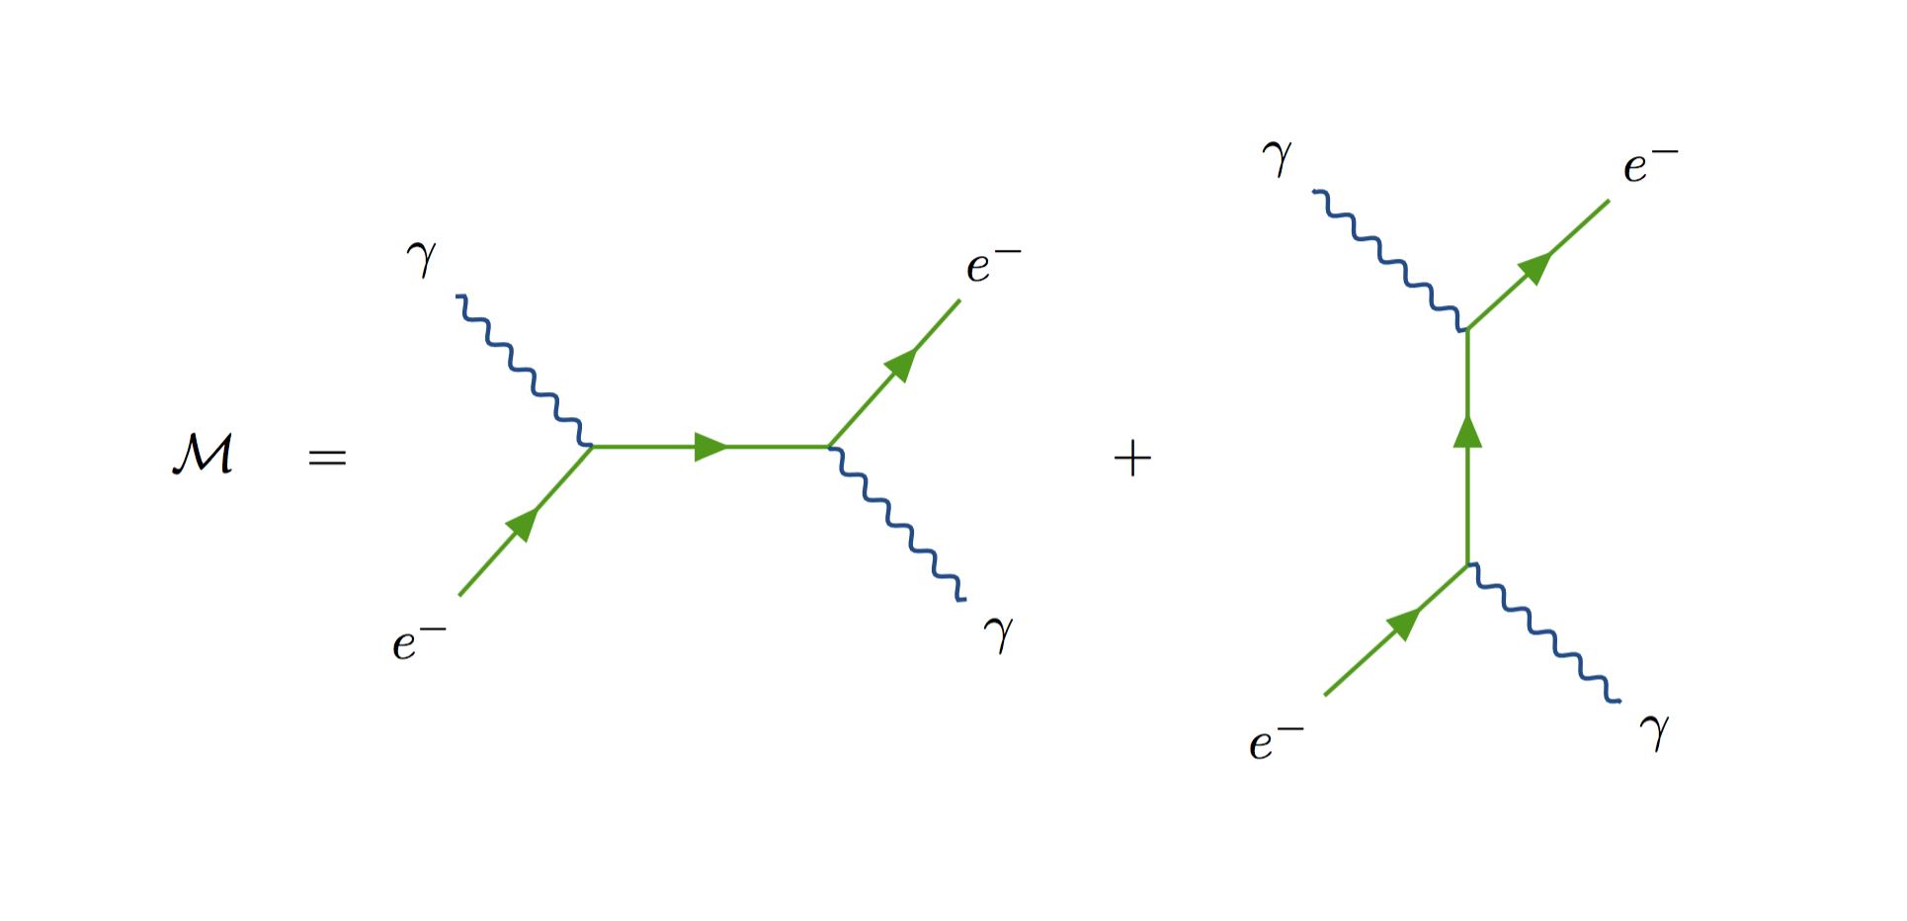
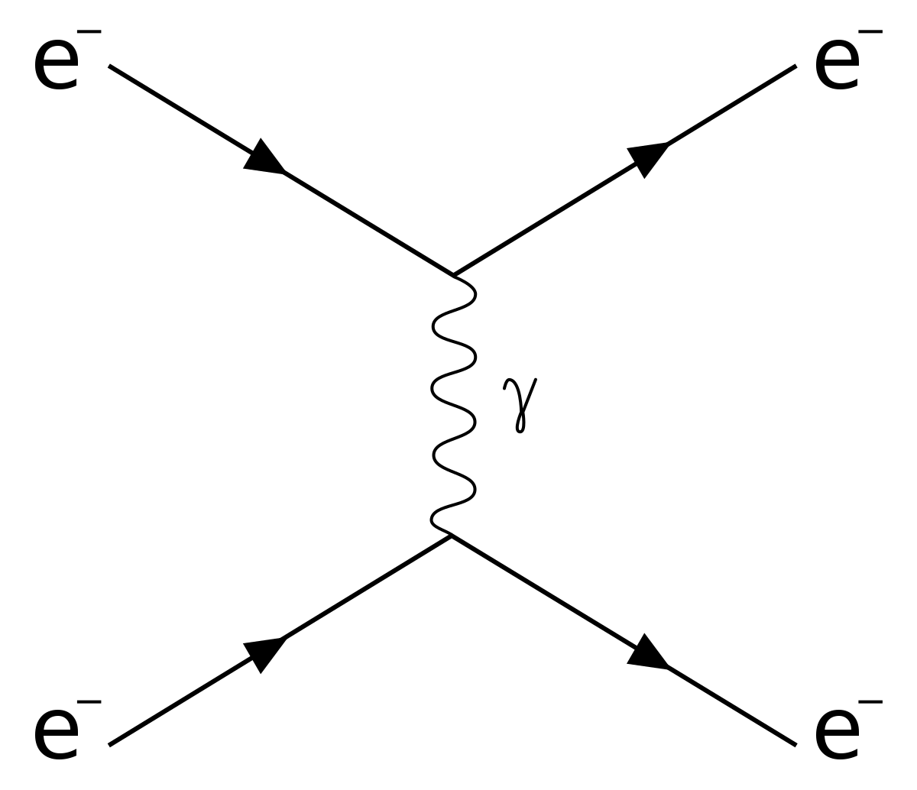
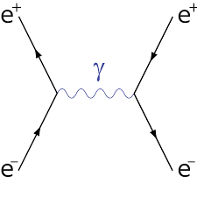
Quantum Electrodynamics (QED) Intro. To Feynman diagrams
Fundamental Process $e^{−}→e^{− }+γ$
Feynman diagrams do not represent trajectories
Möller Scattering
Bhabha Scattering
Compton Scattering

Slide 4
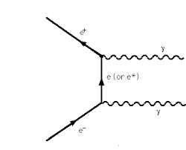
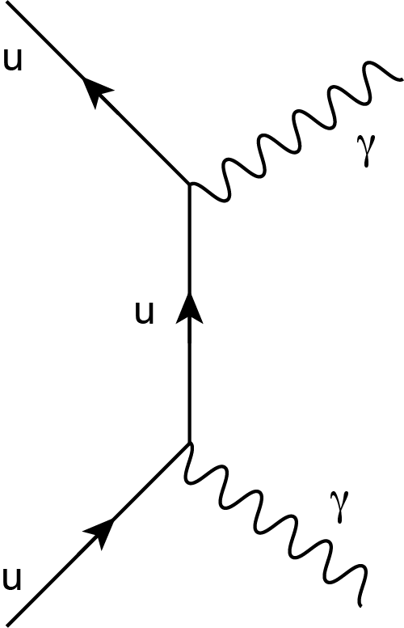
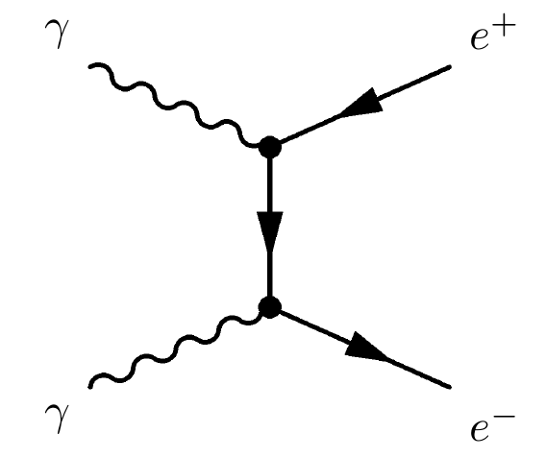
Quantum Electrodynamics (QED)
$$π^{0}→γ γ$$
$$e^{+} e^{−}→γ γ$$
$$γ γ→ e^{+} e^{−}$$
$$π^{0} → \frac{1}{\sqrt{2}} \left(u \overline{u} − d \overline{d}\right)$$

Slide 5
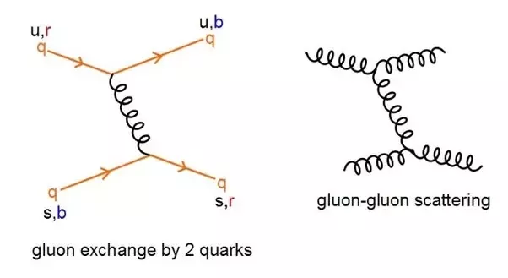
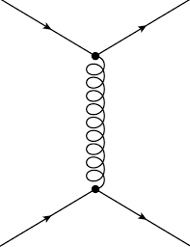
Quantum Chromodynamics (QCD)
Color plays the role of “charge.”
Fundamental Process $q→q+g$
q
q
q
q

Slide 6
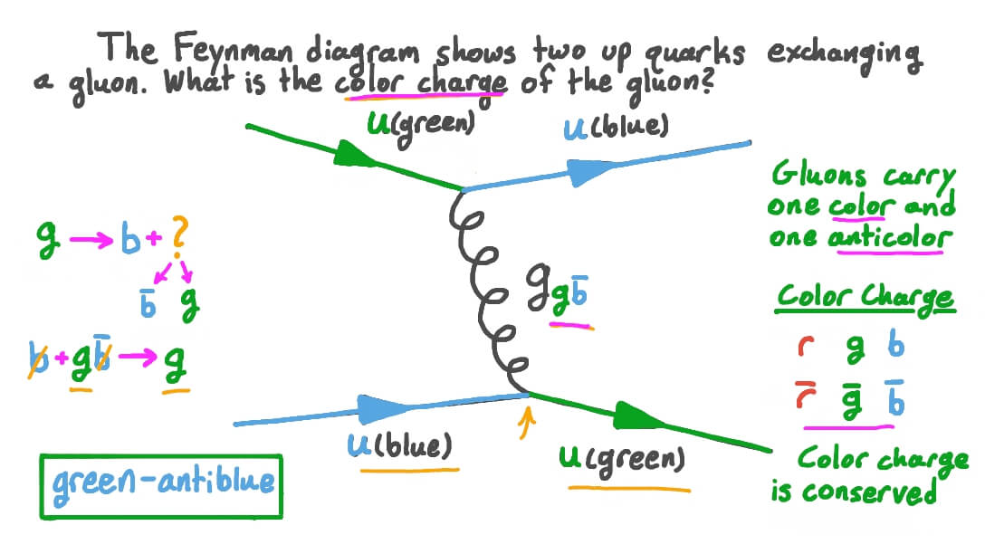
Quantum Chromodynamics (QCD)

Slide 7
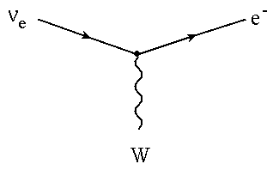
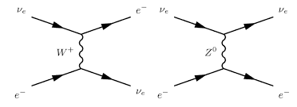
Weak Interactions
Fundamental Interaction
+
Charged and Neutral Currents

Slide 8
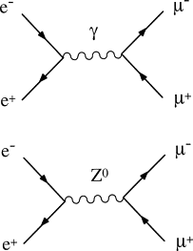
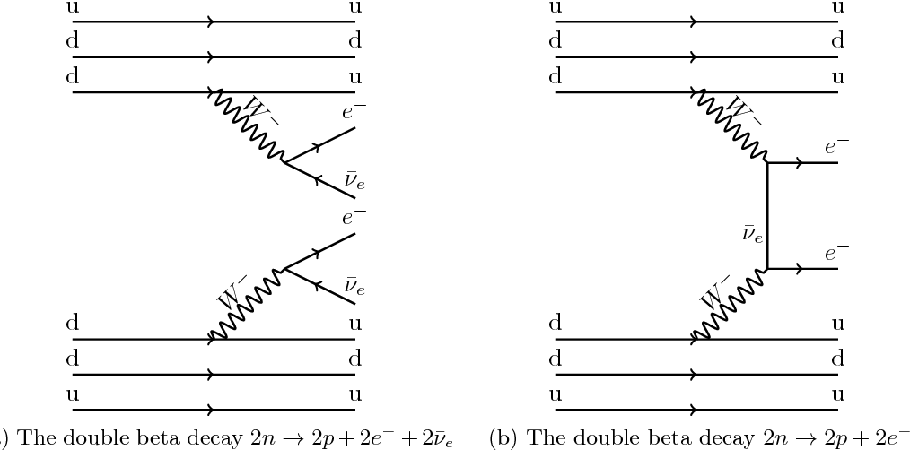
Weak Interactions
Electroweak Interactions
Double Beta Decay

Slide 9
More to Come

